Slide 1


MEDIZINAID
A Small Help For Better Cure

Slide 2

ABOUT
Medizinaid is A quick response assistance in an emergency situation for the patients registered with us.

Slide 3


REGISTRATION
Gathering information
The information of the Doctors and patients is important because
the cure for the patients can be done depending on this information.

Slide 4
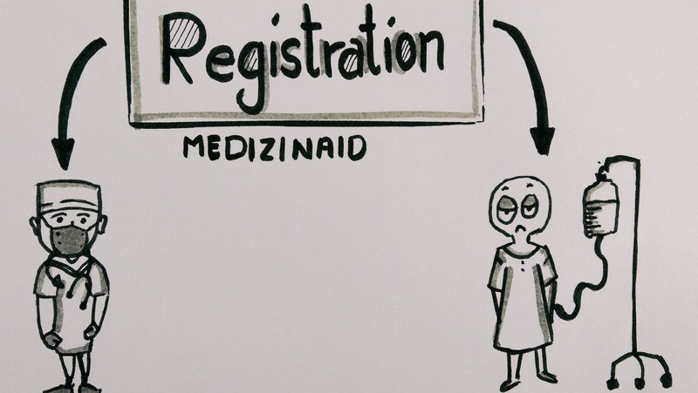
INFORMATION SUCH AS NAME, EMAIL, PASSWORD,
VERIFICATION OF DOCTOR, AND ALSO
VERIFICATION OF PATIENT

Slide 5
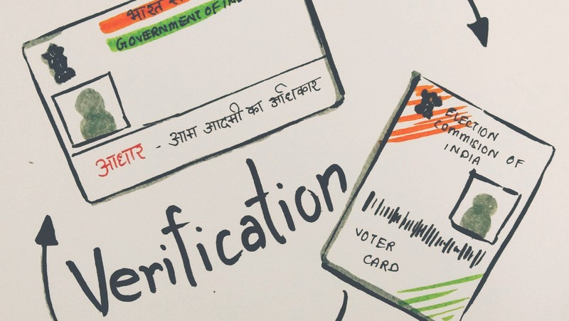


Slide 6



VERIFICATION OF PATIENT
For verification of patient, the website will store the information of their aadhar card and voter ID card i.e., Aadhar number and Voter card number.

Slide 7





Medizinaid is efficient in an emergency situation. There will be two situations, that is a first emergency case which can be treated on the spot and another is which has to be treated at the hospital

Slide 8

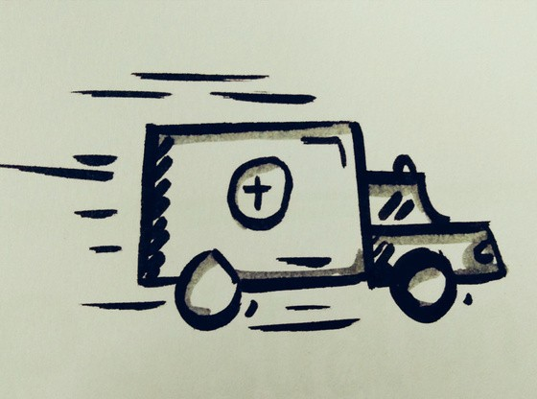
EMERGENCY
In case of the on the spot emergency, the patient can immediately send the alert to the nearest doctor available and doctor will provide the required cure.
in case of the emergency in which the patient must be taken to hospital, the website will provide the location of nearest hospital and will also help in having appointment online.

Slide 9
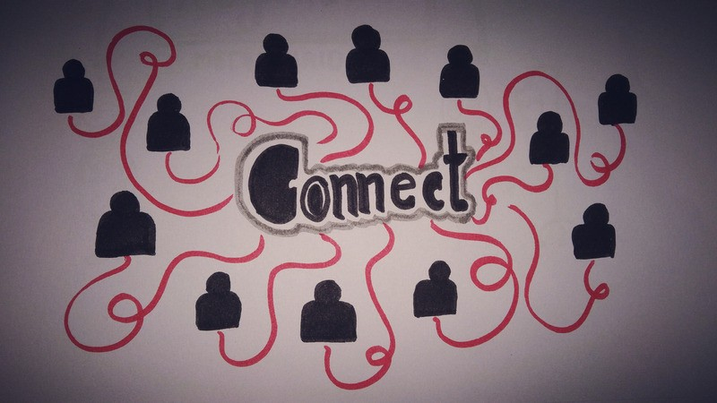

Slide 10
WE B SI T E WI LL C O N N E CT ALL THE HOSPITALS WITH THEM.
The patients will be connected with the website with full privacy.
The details of the patient will only be shared with the doctors who accepts the alert at the time of emergency

Slide 11



Slide 12

IN NORMAL CHECK UP
In normal check ups, patient will choose doctor from the medical field chosen by them, and then they can connect with doctor through chat, audio call and video call.

Slide 13
NOT JUST A WEBSITE.....
Medizinaid will even provide a platform for registered doctors to share their articles, ideas on healthy living, and much more.
The articles can be used as a first-aid solution in the case of an emergency.
" not just A website, but also a source of
good information on health "

Slide 14
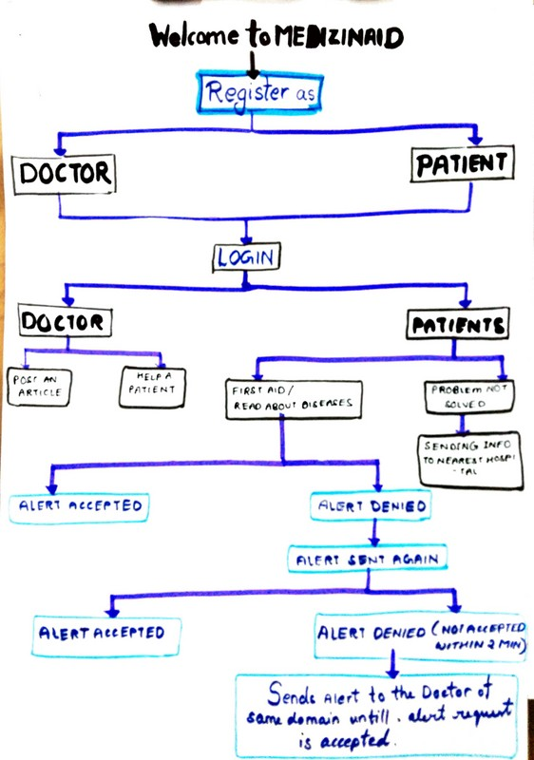
SUMMARY

Slide 15
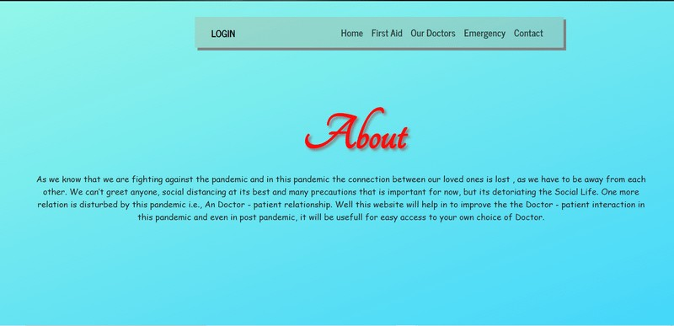
DEMO

Slide 16
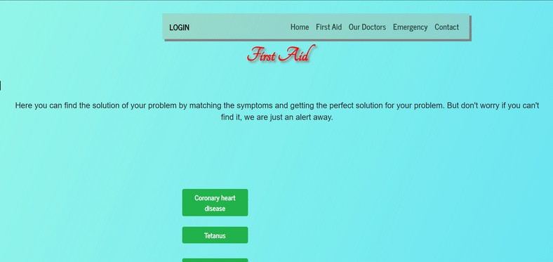

Slide 17
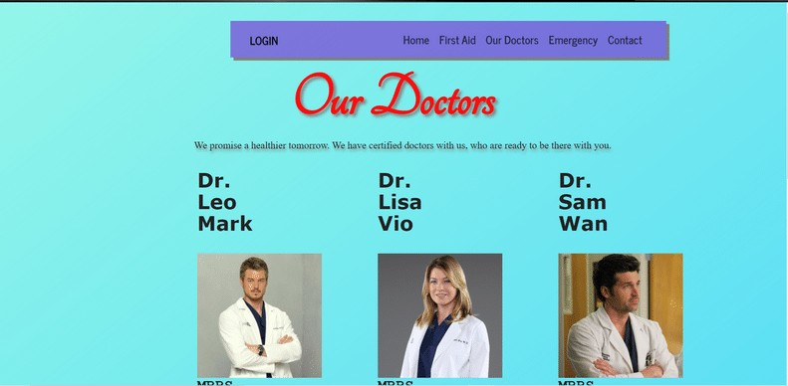

Slide 18
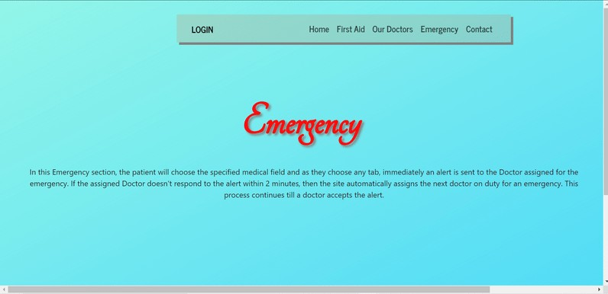

Slide 19
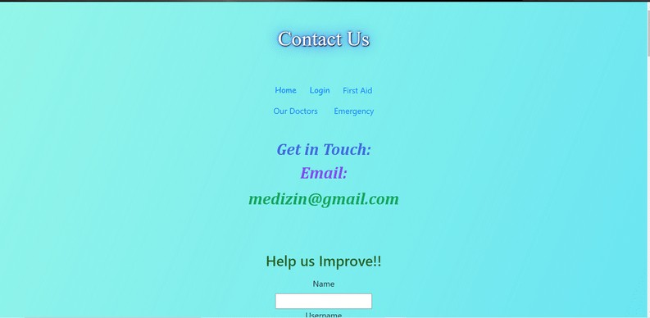

Slide 20
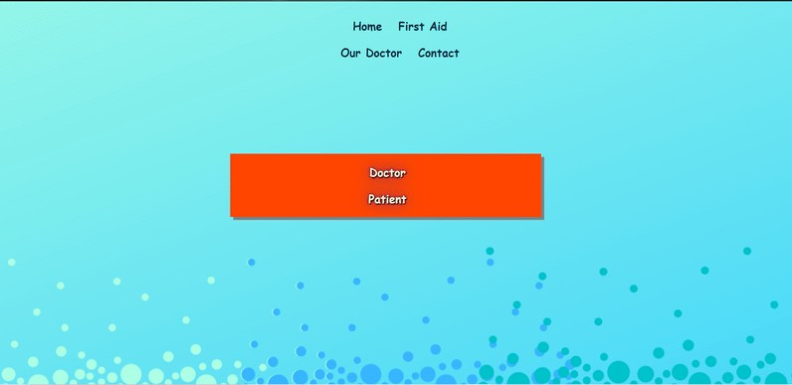

Slide 21
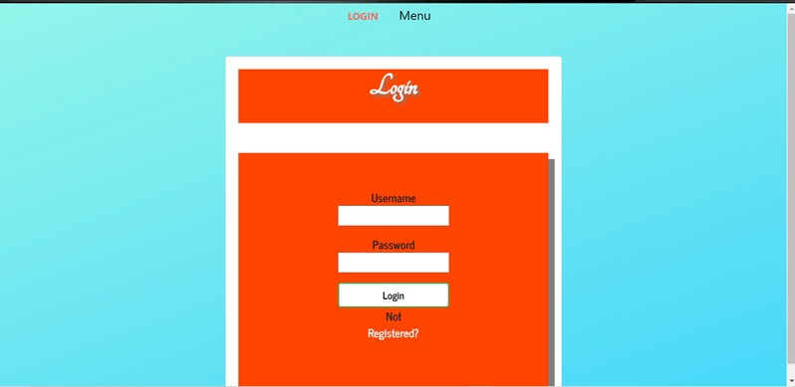

Slide 22
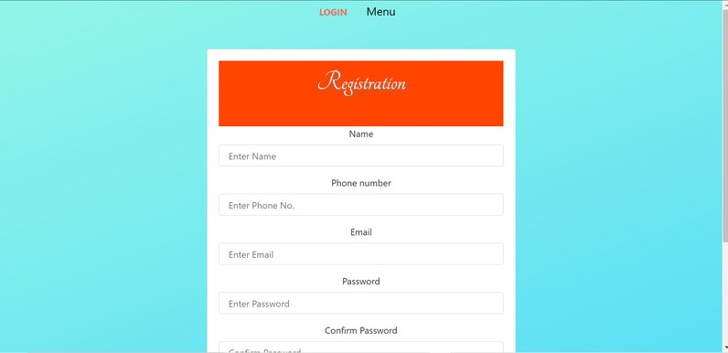

Slide 23
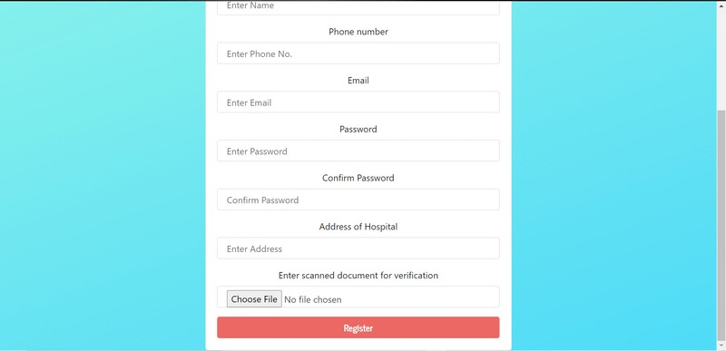

Slide 24
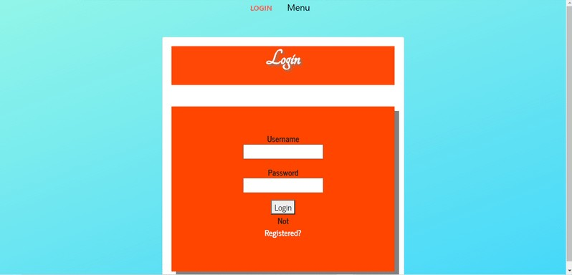

Slide 25
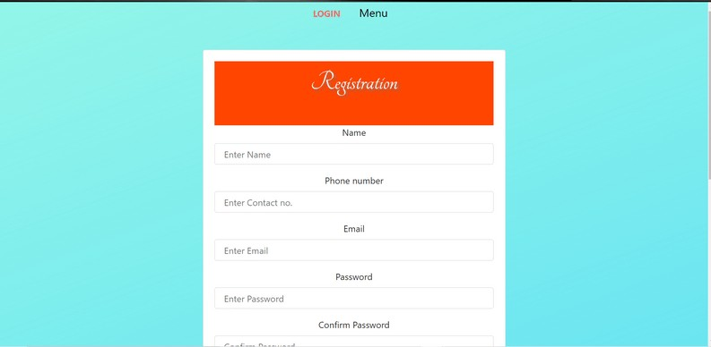

Slide 26
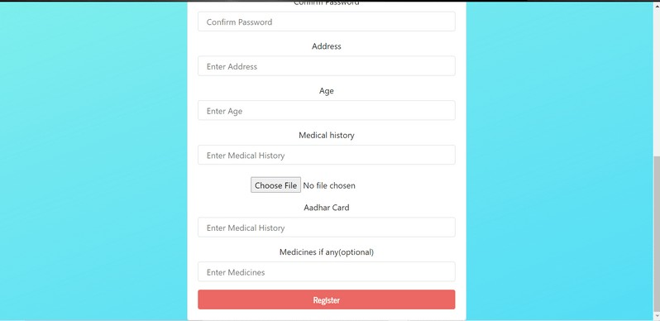

Slide 27

TEAM HOLOWITZ WOLOWITZ
MORE THE TRANSPARENCY, MORE THE TRUST
Team Members :
Ananya Singh
Priyangshu Sen
Priyangshu Bose
Amit Kumar
Email Address
medizinaid@gmail.xom
Website
Just a prototype

